Slide 1
Storage
Raid levels
Presented by
Naredla Gangavamshi -152851

Slide 2
Slide Plan
what is RAID ?
Different types of RAID levels
RAID 0
RAID 1
RAID 2
- Hamming code
RAID 3
RAID 4
RAID 5
RAID 6
RAID 10
CONCLUSION

Slide 3
RAID
RAID used to stand for redundant array of inexpensive/independent disks.
RAID is a way of grouping individual physical drives together to form one bigger drive called a RAID set.
Notes:
Usar para separador de capitulos . Seria bom ter esta versao em vermelho e verde tb..

Slide 4
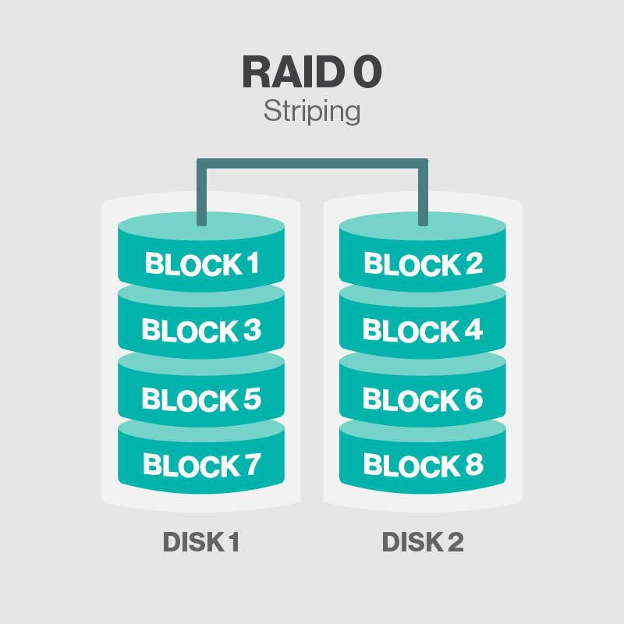
RAID 0
RAID 0 is called disk striping

Slide 5
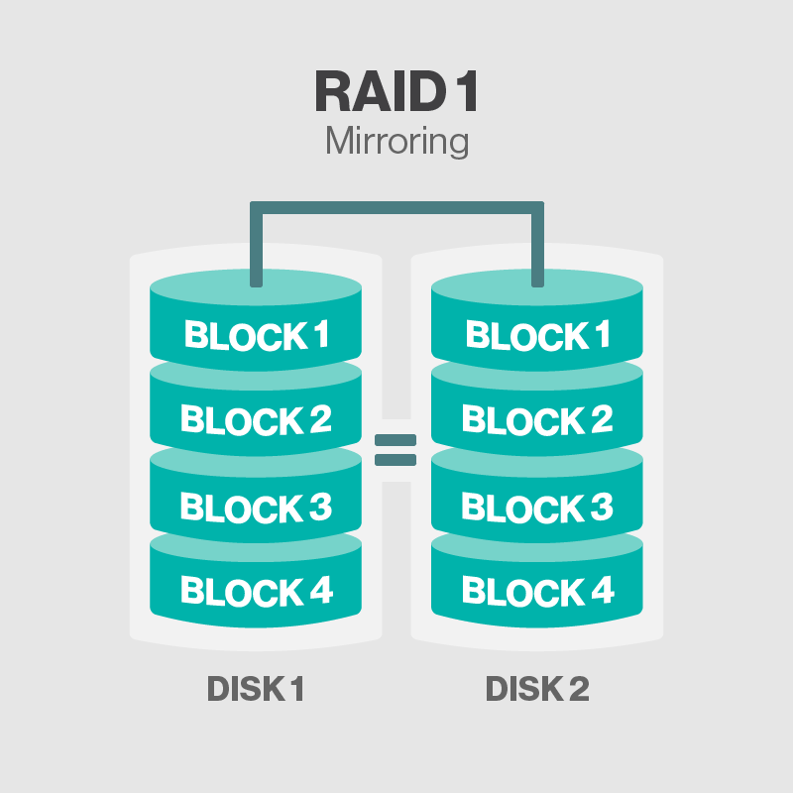
RAID 1
RAID 1 is also called disk mirroring

Slide 6
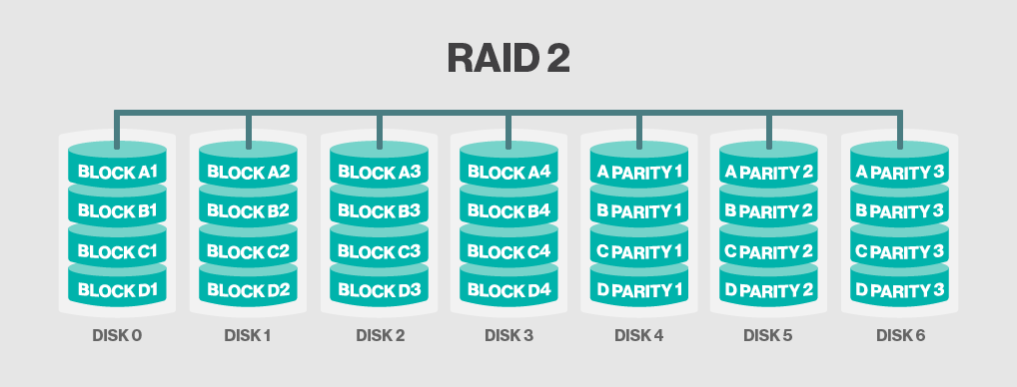
RAID 2
RAID 2 stripes data at the bit level using hamming code

Slide 7
Hamming Code
Redundant bits
2^r > m + r + 1
where, r = redundant bit, m = data bit
Parity bits
Hamming code is a set of error-correction codes that can be used to detect and correct the errors
It is developed by R.W. Hamming for error correction
Even parity bit
Odd Parity bit

Slide 8
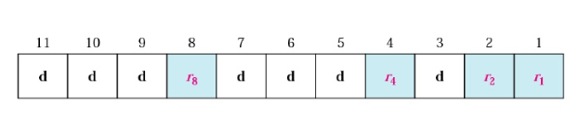
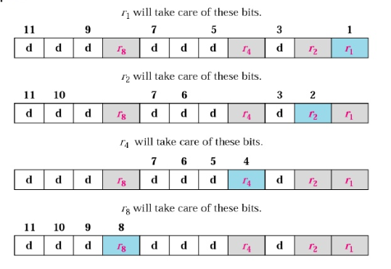
Redundant bit calculation

Slide 10
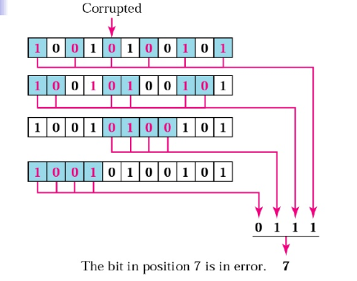
Code sent was 10011100101
Code receives as 10010100101

Slide 11
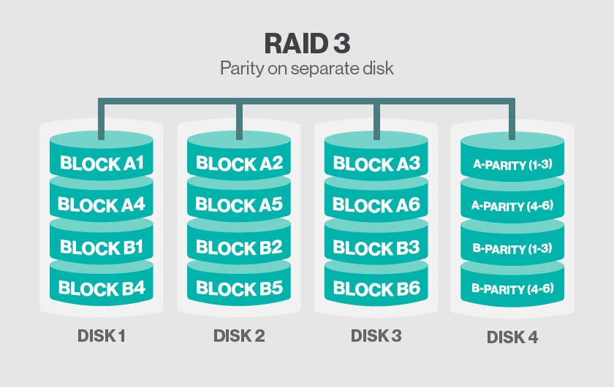
RAID 3
RAID 3 uses Parity on Separate Disk

Slide 12
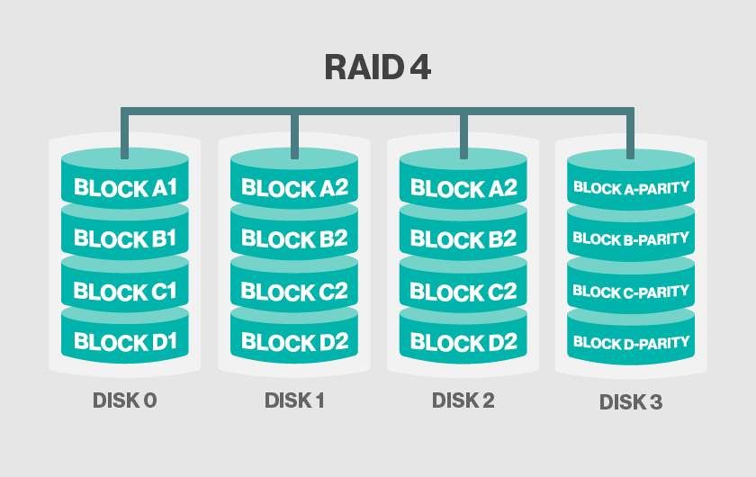
RAID 4
RAID 4 uses separate parity and block level Striping

Slide 13
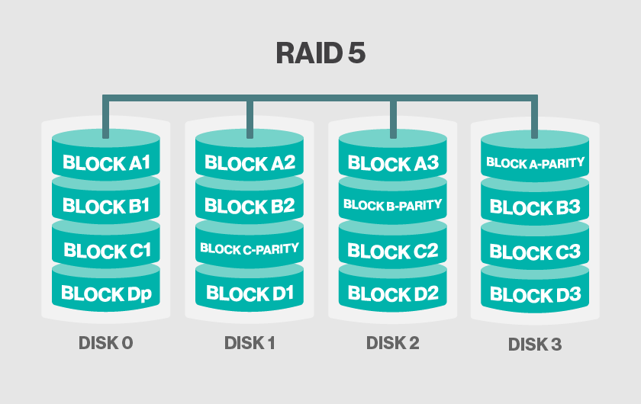
RAID 5
RAID 5 uses disk striping with parity

Slide 14
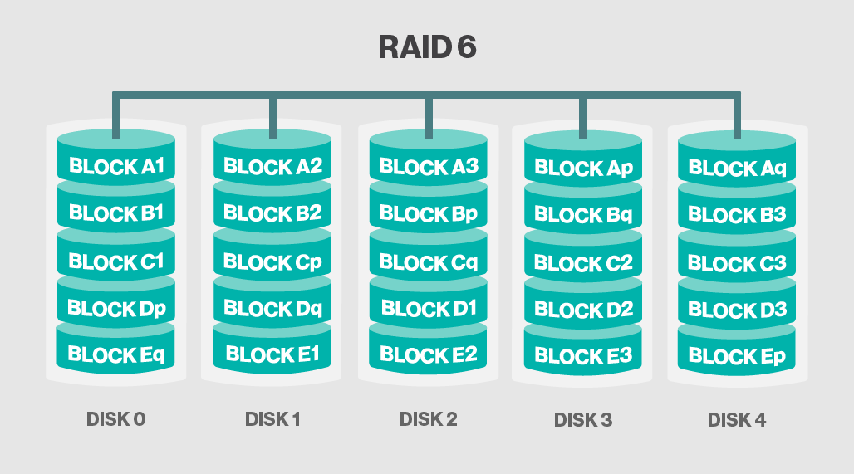
RAID 6
RAID 6 increases reliability by utilizing two parity stripes

Slide 15
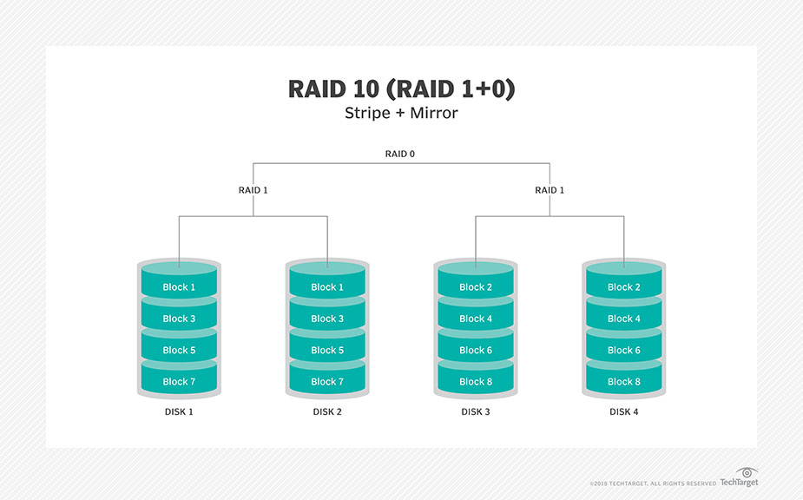
RAID 10
RAID 10 uses a combination of disk mirroring and disk Striping

Slide 16
THANK YOU

